Slide 1
Action Recognition
04/21/11
Computer Vision
CS 543 / ECE 549
University of Illinois
Derek Hoiem

Slide 2
This section: advanced topics
Action recognition
3D Scenes and Context
Massively data-driven approaches

Slide 3
Today: action recognition
Action recognition
What is an “action”?
How can we represent movement?
How do we incorporate motion, pose, and nearby objects?

Slide 4

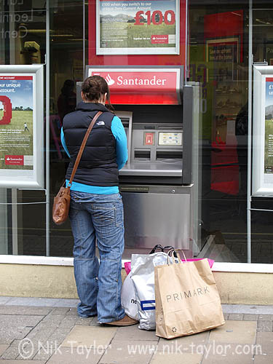
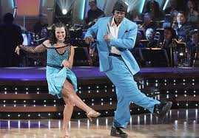
What is an action?
Action: a transition from one state to another
Who is the actor?
How is the state of the actor changing?
What (if anything) is being acted on?
How is that thing changing?
What is the purpose of the action (if any)?

Slide 5
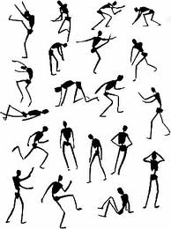
How do we represent actions?
Categories
Walking, hammering, dancing, skiing, sitting down, standing up, jumping
Poses
Nouns and Predicates
<man, swings, hammer>
<man, hits, nail, w/ hammer>

Slide 6
What is the purpose of action recognition?
To describe
http://www.youtube.com/watch?v=bxJOhOna9OQ
To predict
http://www.youtube.com/watch?v=LQm25nW6aZw

Slide 7
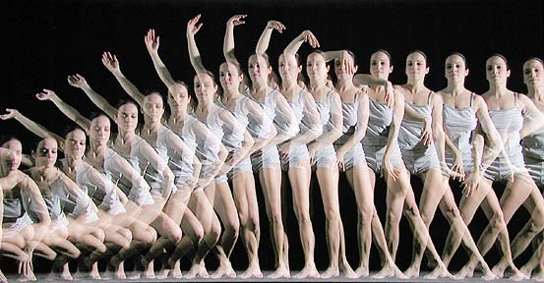
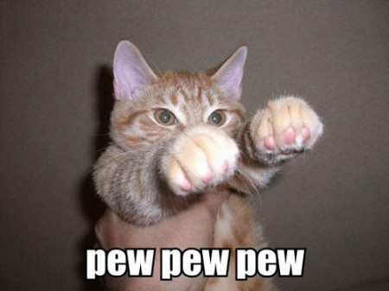

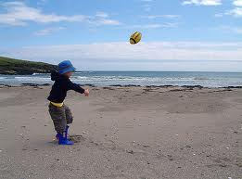
How can we identify actions?
Motion
Pose
Held Objects
Nearby Objects

Slide 8
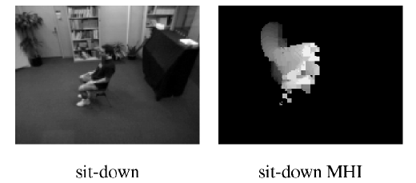
Representing Motion
Optical Flow with Motion History
Bobick Davis 2001
Notes:
Values reflect magnitude and recentness of movements

Slide 9
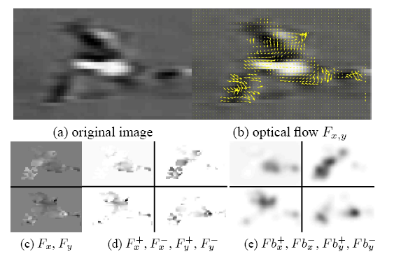
Representing Motion
Optical Flow with Split Channels
Efros et al. 2003

Slide 10
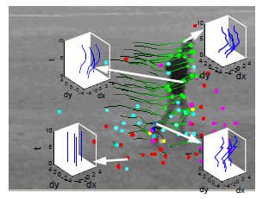
Representing Motion
Tracked Points
Matikainen et al. 2009
Notes:
Point tracks reflect long-term motions

Slide 11
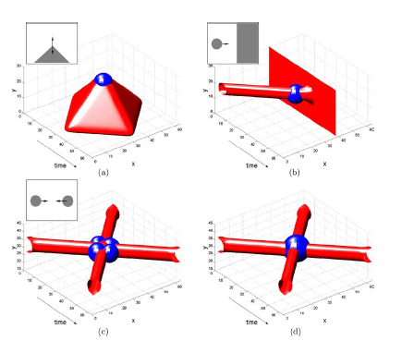
Representing Motion
Space-Time Interest Points
Corner detectors in space-time
Laptev 2005
Notes:
Detect interest points in time and position

Slide 12
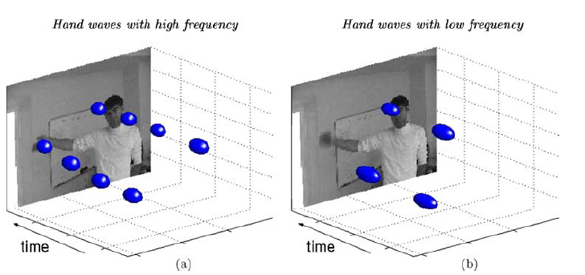
Representing Motion
Space-Time Interest Points
Laptev 2005
Notes:
Detect interest points in time and position

Slide 13
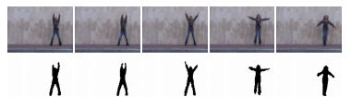
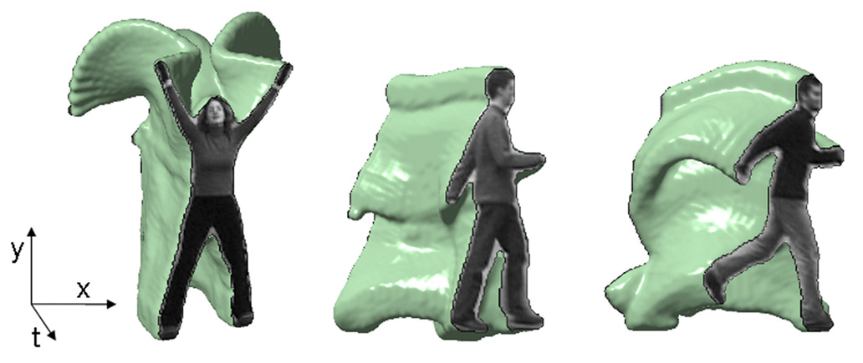
Representing Motion
Space-Time Volumes
Blank et al. 2005

Slide 14
Examples of Action Recognition Systems
Feature-based classification
Recognition using pose and objects

Slide 15
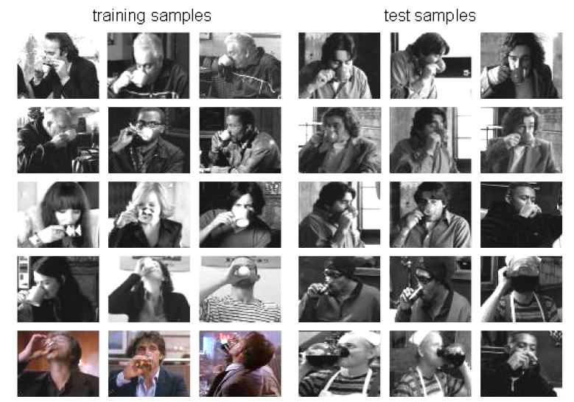
Action recognition as classification
Retrieving actions in movies, Laptev and Perez, 2007

Slide 16
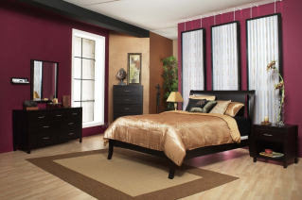
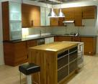


Remember image categorization…
Training
Training Labels
Training Images
Image Features
Classifier Training
Trained Classifier

Slide 17
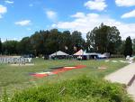
Remember image categorization…
Training
Training Labels
Training Images
Image Features
Classifier Training
Trained Classifier
Testing
Image Features
Trained Classifier
Prediction
Outdoor
Test Image

Slide 18
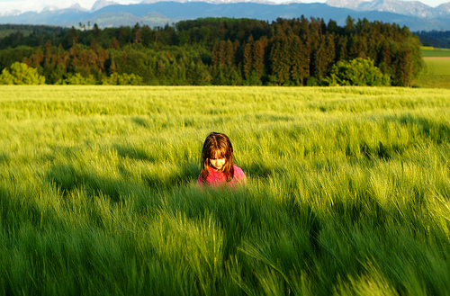
Remember spatial pyramids….
Compute histogram in each spatial bin

Slide 19
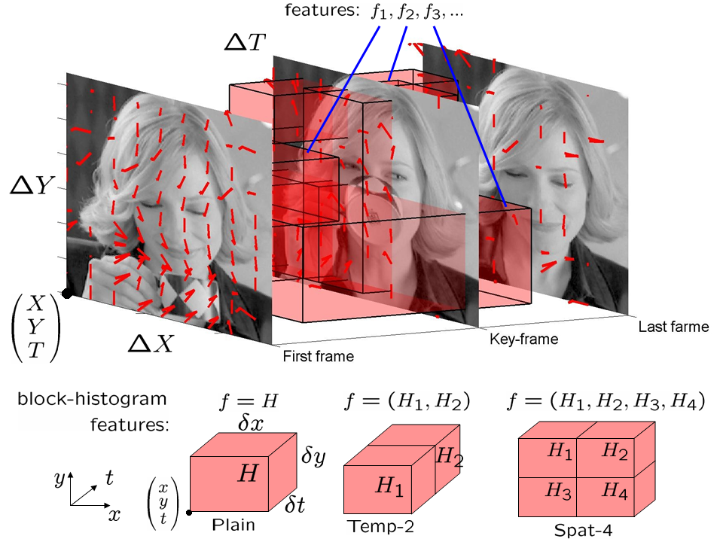
Features for Classifying Actions
Spatio-temporal pyramids (14x14x8 bins)
Image Gradients
Optical Flow

Slide 20
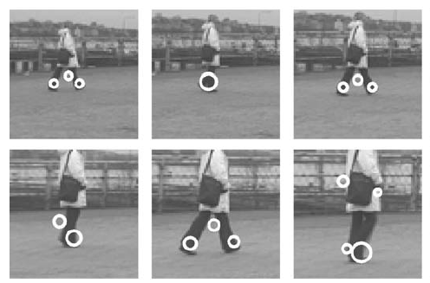
Features for Classifying Actions
Spatio-temporal interest points
Corner detectors in space-time
Descriptors based on Gaussian derivative filters over x, y, time

Slide 21
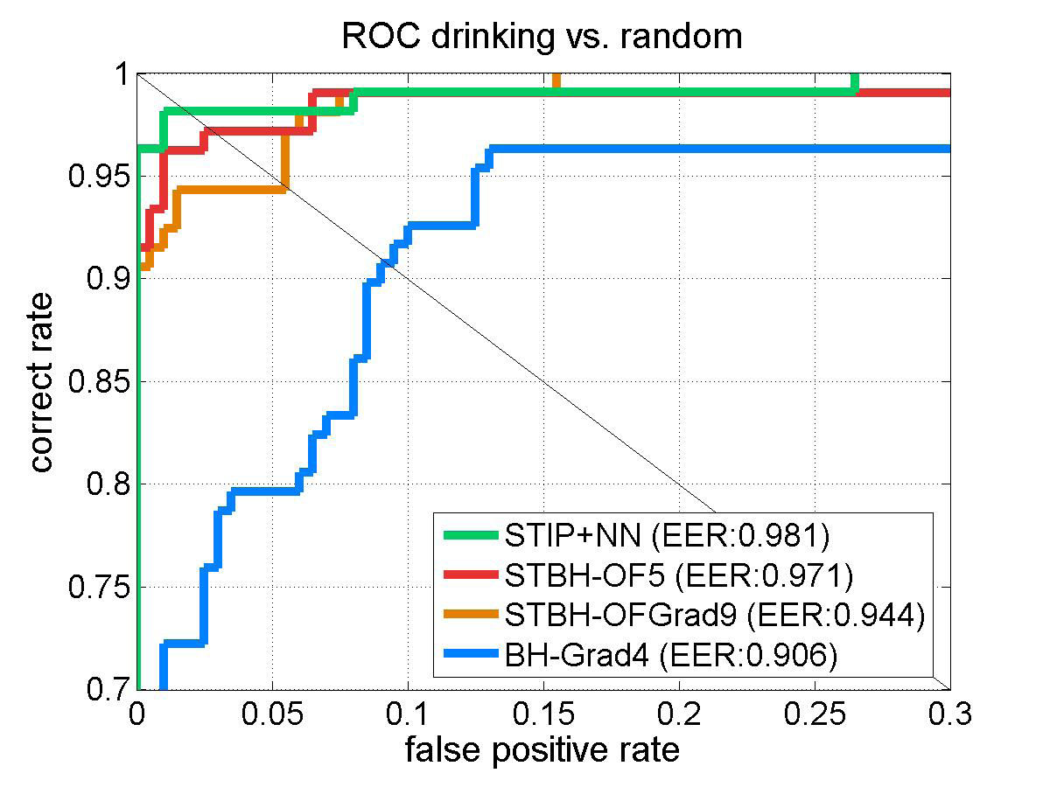
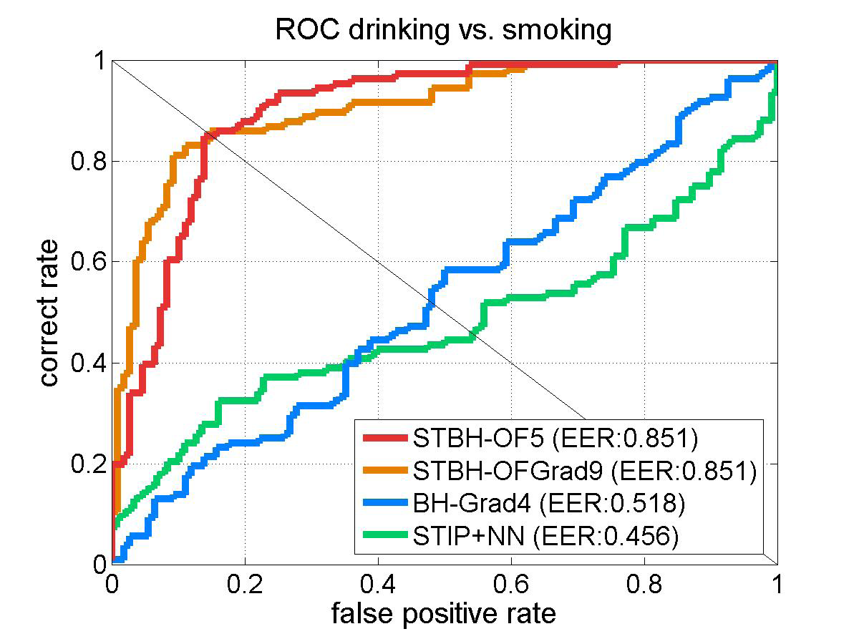
Classification
Boosted stubs for pyramids of optical flow, gradient
Nearest neighbor for STIP

Slide 22
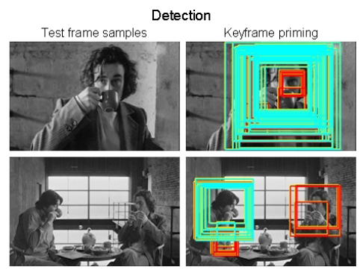
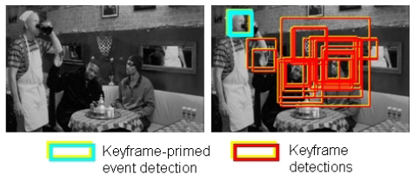
Searching the video for an action
Detect keyframes using a trained HOG detector in each frame
Classify detected keyframes as positive (e.g., “drinking”) or negative (“other”)

Slide 23
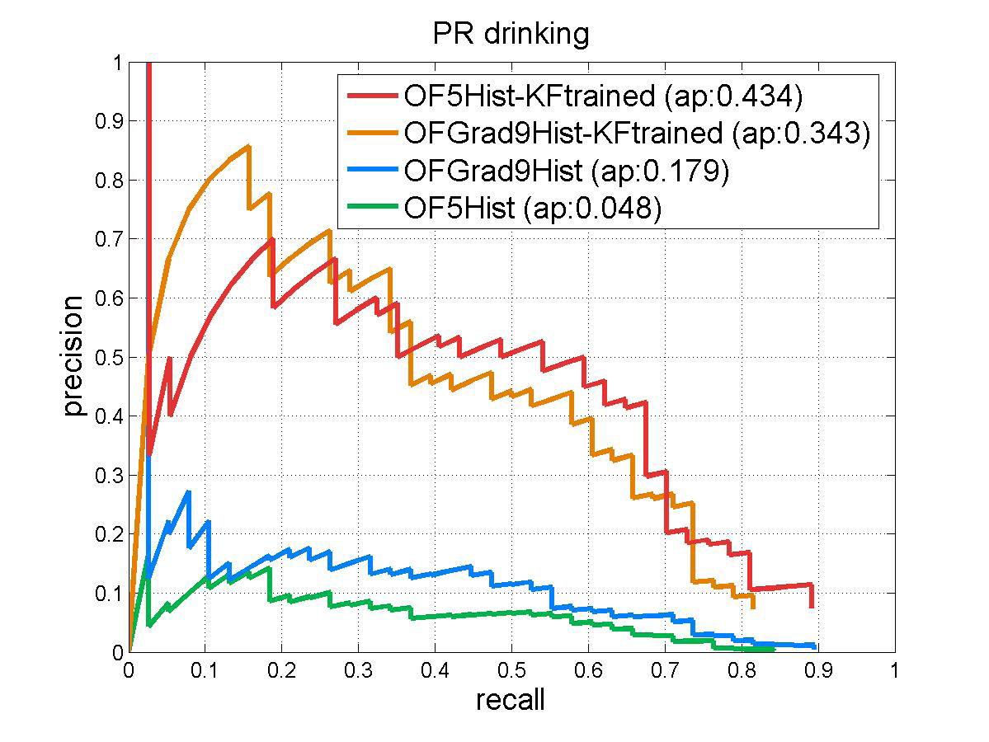
Accuracy in searching video
With keyframe detection
Without keyframe detection

Slide 24

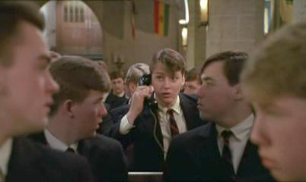
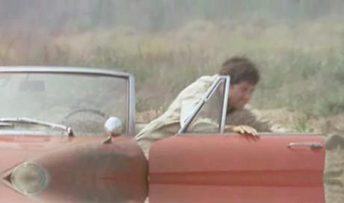
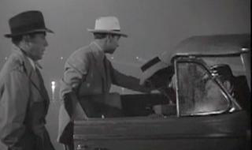
“Talk on phone”
“Get out of car”
Learning realistic human actions from movies, Laptev et al. 2008

Slide 25
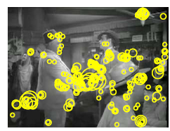
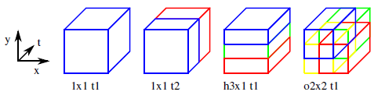
Approach
Space-time interest point detectors
Descriptors
HOG, HOF
Pyramid histograms (3x3x2)
SVMs with Chi-Squared Kernel
Spatio-Temporal Binning
Interest Points

Slide 26
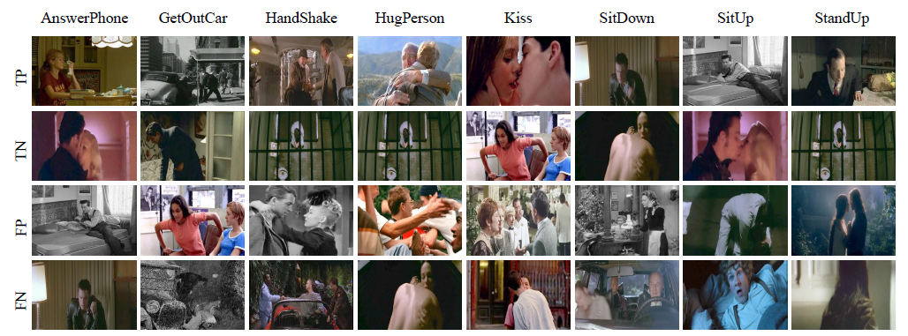
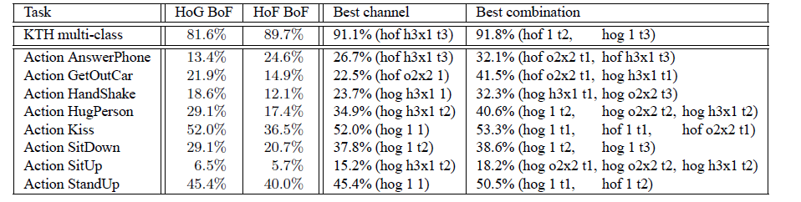
Results

Slide 27
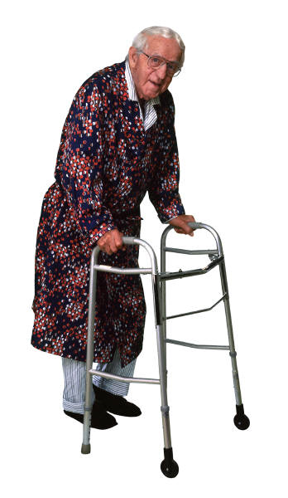
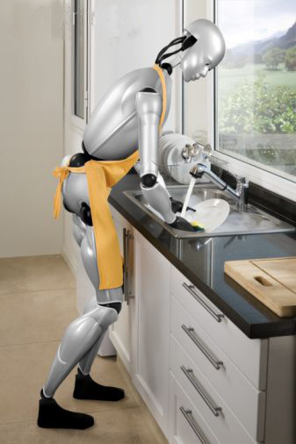
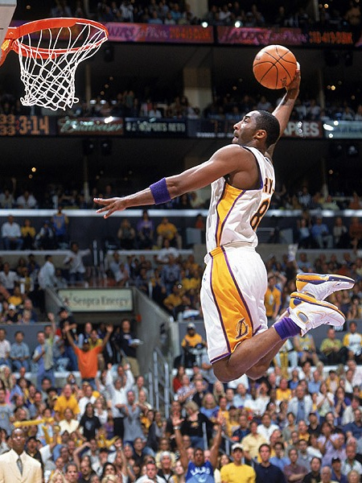
Action Recognition using Pose and Objects
Modeling Mutual Context of Object and Human Pose in Human-Object Interaction Activities, B. Yao and Li Fei-Fei, 2010
Slide Credit: Yao/Fei-Fei

Slide 28
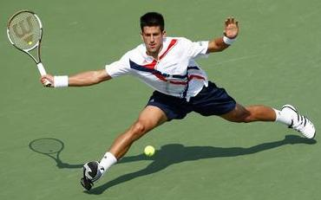
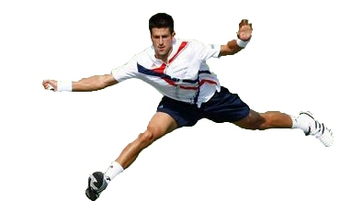
Human-Object Interaction
Holistic image based classification
Integrated reasoning
Human pose estimation
Head
Right-arm
Left-arm
Torso
Right-leg
Left-leg
Slide Credit: Yao/Fei-Fei

Slide 29

Human-Object Interaction
Holistic image based classification
Integrated reasoning
Human pose estimation
Object detection
Tennis racket
Slide Credit: Yao/Fei-Fei

Slide 30
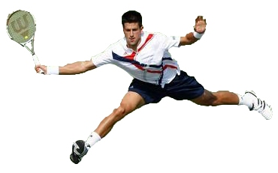
Human-Object Interaction
Holistic image based classification
Integrated reasoning
Human pose estimation
Object detection
Action categorization
Head
Right-arm
Left-arm
Tennis racket
Torso
Right-leg
Left-leg
HOI activity: Tennis Forehand
Slide Credit: Yao/Fei-Fei

Slide 31
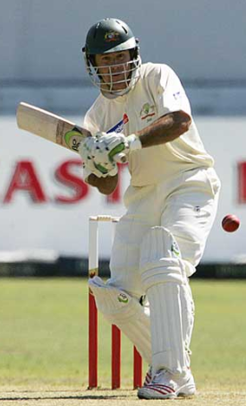
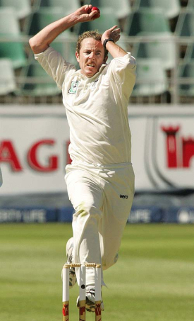
Human pose estimation & Object detection
Human pose estimation is challenging.
Difficult part appearance
Self-occlusion
Image region looks like a body part
Felzenszwalb & Huttenlocher, 2005
Ren et al, 2005
Ramanan, 2006
Ferrari et al, 2008
Yang & Mori, 2008
Andriluka et al, 2009
Eichner & Ferrari, 2009
Slide Credit: Yao/Fei-Fei

Slide 32
Human pose estimation & Object detection
Human pose estimation is challenging.
Felzenszwalb & Huttenlocher, 2005
Ren et al, 2005
Ramanan, 2006
Ferrari et al, 2008
Yang & Mori, 2008
Andriluka et al, 2009
Eichner & Ferrari, 2009
Slide Credit: Yao/Fei-Fei

Slide 33
Human pose estimation & Object detection
Facilitate
Given the object is detected.
Slide Credit: Yao/Fei-Fei

Slide 34
Human pose estimation & Object detection
Object detection is challenging
Small, low-resolution, partially occluded
Image region similar to detection target
Viola & Jones, 2001
Lampert et al, 2008
Divvala et al, 2009
Vedaldi et al, 2009
Slide Credit: Yao/Fei-Fei

Slide 35
Human pose estimation & Object detection
Object detection is challenging
Viola & Jones, 2001
Lampert et al, 2008
Divvala et al, 2009
Vedaldi et al, 2009
Slide Credit: Yao/Fei-Fei

Slide 36
Human pose estimation & Object detection
Facilitate
Given the pose is estimated.
Slide Credit: Yao/Fei-Fei

Slide 37

Human pose estimation & Object detection
Mutual Context
Slide Credit: Yao/Fei-Fei

Slide 38
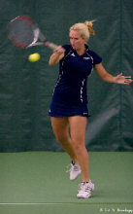
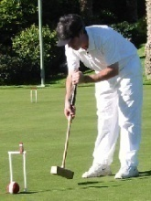
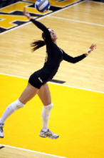
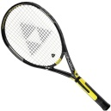
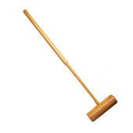
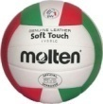

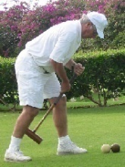
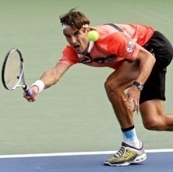
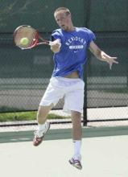
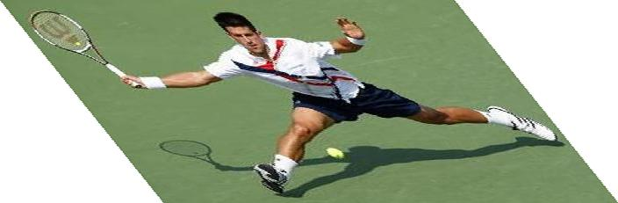

Mutual Context Model Representation
A:
Activity
A
Tennis forehand
Croquet shot
Volleyball smash
Human pose
H
O:
Object
O
Tennis racket
Croquet mallet
Volleyball
Body parts
P₁
P₂
P_{N}
H:
f_{O}
f₁
f₂
f_{N}
Intra-class variations
More than one H for each A;
Unobserved during training.
Image evidence
P:
l_{P}: location; θ_{P}: orientation; s_{P}: scale.
f:
Shape context.
[Belongie et al, 2002]
Slide Credit: Yao/Fei-Fei

Slide 39
Mutual Context Model Representation
Markov Random Field
, , : Frequency of co-occurrence between A, O, and H.
A
Clique weight
Clique potential
H
O
P₁
P₂
P_{N}
f_{O}
f₁
f₂
f_{N}
Slide Credit: Yao/Fei-Fei

Slide 40
Mutual Context Model Representation
Markov Random Field
, , : Frequency of co-occurrence between A, O, and H.
A
, , : Spatial relationship among object and body parts.
Clique weight
Clique potential
H
O
location
orientation
size
P₁
P₂
P_{N}
f_{O}
f₁
f₂
f_{N}
Slide Credit: Yao/Fei-Fei

Slide 41
Mutual Context Model Representation
Markov Random Field
, , : Frequency of co-occurrence between A, O, and H.
A
, , : Spatial relationship among object and body parts.
Clique weight
Clique potential
H
O
Obtained by structure learning
location
orientation
size
Learn structural connectivity among the body parts and the object.
P₁
P₂
P_{N}
f_{O}
f₁
f₂
f_{N}
Slide Credit: Yao/Fei-Fei

Slide 42
Mutual Context Model Representation
Markov Random Field
, , : Frequency of co-occurrence between A, O, and H.
A
, , : Spatial relationship among object and body parts.
Clique weight
Clique potential
H
O
location
orientation
size
Learn structural connectivity among the body parts and the object.
P₁
P₂
P_{N}
f_{O}
and : Discriminative part detection scores.
f₁
f₂
f_{N}
Shape context + AdaBoost
[Andriluka et al, 2009]
[Belongie et al, 2002]
[Viola & Jones, 2001]
Slide Credit: Yao/Fei-Fei

Slide 43






Model Learning
A
Input:
H
O
cricket shot
cricket bowling
P₁
P₂
P_{N}
f_{O}
f₁
f₂
f_{N}
Goals:
Hidden human poses
Slide Credit: Yao/Fei-Fei

Slide 44
Model Learning
A
Input:
H
O
cricket shot
cricket bowling
P₁
P₂
P_{N}
f_{O}
f₁
f₂
f_{N}
Goals:
Hidden human poses
Structural connectivity
Slide Credit: Yao/Fei-Fei

Slide 45
Model Learning
A
Input:
H
O
cricket shot
cricket bowling
P₁
P₂
P_{N}
f_{O}
f₁
f₂
f_{N}
Goals:
Hidden human poses
Structural connectivity
Potential parameters
Potential weights
Slide Credit: Yao/Fei-Fei

Slide 46
Model Learning
A
Input:
H
O
cricket shot
cricket bowling
P₁
P₂
P_{N}
f_{O}
f₁
f₂
f_{N}
Goals:
Hidden human poses
Hidden variables
Structural connectivity
Structure learning
Potential parameters
Parameter estimation
Potential weights
Slide Credit: Yao/Fei-Fei

Slide 47



Model Learning
A
Approach:
H
croquet shot
O
P₁
P₂
P_{N}
f_{O}
f₁
f₂
f_{N}
Goals:
Hidden human poses
Structural connectivity
Potential parameters
Potential weights
Slide Credit: Yao/Fei-Fei

Slide 48
Model Learning
A
Approach:
H
Hill-climbing
O
Joint density of the model
Gaussian priori of the edge number
P₁
P₂
P_{N}
f_{O}
f₁
f₂
f_{N}
Add an edge
Remove an edge
Goals:
Hidden human poses
Structural connectivity
Potential parameters
Add an edge
Remove an edge
Potential weights
Slide Credit: Yao/Fei-Fei

Slide 49
Model Learning
A
Approach:
H
Maximum likelihood
O
P₁
P₂
P_{N}
f_{O}
Standard AdaBoost
f₁
f₂
f_{N}
Goals:
Hidden human poses
Structural connectivity
Potential parameters
Potential weights
Slide Credit: Yao/Fei-Fei

Slide 50
Model Learning
A
Approach:
H
Max-margin learning
O
P₁
P₂
P_{N}
f_{O}
f₁
f₂
f_{N}
Goals:
Hidden human poses
Notations
Structural connectivity
x_{i}: Potential values of the i-th image.
w_{r}: Potential weights of the r-th pose.
y(r): Activity of the r-th pose.
ξ_{i}: A slack variable for the i-th image.
Potential parameters
Potential weights
Slide Credit: Yao/Fei-Fei

Slide 51


















Learning Results
Cricket defensive shot
Cricket bowling
Croquet shot
Slide Credit: Yao/Fei-Fei

Slide 52


















Learning Results
Tennis forehand
Tennis serve
Volleyball smash
Slide Credit: Yao/Fei-Fei

Slide 53




Model Inference
The learned models
Slide Credit: Yao/Fei-Fei

Slide 54



Model Inference
The learned models
Head detection
Torso detection
Compositional Inference
[Chen et al, 2007]
Tennis racket detection
Layout of the object and body parts.
Slide Credit: Yao/Fei-Fei

Slide 55
Model Inference
The learned models
Output
Slide Credit: Yao/Fei-Fei

Slide 56






Dataset and Experiment Setup
Sport data set: 6 classes
180 training (supervised with object and part locations) & 120 testing images
Tasks:
Object detection;
Pose estimation;
Activity classification.
Cricket defensive shot
Cricket bowling
Croquet shot
Tennis forehand
Tennis serve
Volleyball smash
[Gupta et al, 2009]
Slide Credit: Yao/Fei-Fei

Slide 57
Dataset and Experiment Setup
Sport data set: 6 classes
180 training (supervised with object and part locations) & 120 testing images
Tasks:
Object detection;
Pose estimation;
Activity classification.
Cricket defensive shot
Cricket bowling
Croquet shot
Tennis forehand
Tennis serve
Volleyball smash
[Gupta et al, 2009]
Slide Credit: Yao/Fei-Fei

Slide 58









Object Detection Results
Cricket bat
Cricket ball
Valid region
Sliding window
Pedestrian context
Our Method
[Andriluka et al, 2009]
[Dalal & Triggs, 2006]
Croquet mallet
Tennis racket
Volleyball
Slide Credit: Yao/Fei-Fei

Slide 59






Object Detection Results
Sliding window
Pedestrian context
Our method
Cricket ball
Small object
Volleyball
Background clutter
Slide Credit: Yao/Fei-Fei

Slide 60
Dataset and Experiment Setup
Sport data set: 6 classes
180 training & 120 testing images
Tasks:
Object detection;
Pose estimation;
Activity classification.
Cricket defensive shot
Cricket bowling
Croquet shot
Tennis forehand
Tennis serve
Volleyball smash
[Gupta et al, 2009]
Slide Credit: Yao/Fei-Fei

Slide 61
Human Pose Estimation Results
Method | Torso | Upper Leg |  | Lower Leg |  | Upper Arm |  | Lower Arm |  | Head
Ramanan, 2006 | .52 | .22 | .22 | .21 | .28 | .24 | .28 | .17 | .14 | .42
Andriluka et al, 2009 | .50 | .31 | .30 | .31 | .27 | .18 | .19 | .11 | .11 | .45
Our full model | .66 | .43 | .39 | .44 | .34 | .44 | .40 | .27 | .29 | .58
Slide Credit: Yao/Fei-Fei

Slide 62




Human Pose Estimation Results
Method | Torso | Upper Leg |  | Lower Leg |  | Upper Arm |  | Lower Arm |  | Head
Ramanan, 2006 | .52 | .22 | .22 | .21 | .28 | .24 | .28 | .17 | .14 | .42
Andriluka et al, 2009 | .50 | .31 | .30 | .31 | .27 | .18 | .19 | .11 | .11 | .45
Our full model | .66 | .43 | .39 | .44 | .34 | .44 | .40 | .27 | .29 | .58
Tennis serve model
Our estimation result
Andriluka et al, 2009
Volleyball smash model
Our estimation result
Andriluka et al, 2009
Slide Credit: Yao/Fei-Fei

Slide 63






Human Pose Estimation Results
Method | Torso | Upper Leg |  | Lower Leg |  | Upper Arm |  | Lower Arm |  | Head
Ramanan, 2006 | .52 | .22 | .22 | .21 | .28 | .24 | .28 | .17 | .14 | .42
Andriluka et al, 2009 | .50 | .31 | .30 | .31 | .27 | .18 | .19 | .11 | .11 | .45
Our full model | .66 | .43 | .39 | .44 | .34 | .44 | .40 | .27 | .29 | .58
One pose per class | .63 | .40 | .36 | .41 | .31 | .38 | .35 | .21 | .23 | .52
Estimation result
Estimation result
Estimation result
Estimation result
Slide Credit: Yao/Fei-Fei

Slide 64
Dataset and Experiment Setup
Sport data set: 6 classes
180 training & 120 testing images
Tasks:
Object detection;
Pose estimation;
Activity classification.
Cricket defensive shot
Cricket bowling
Croquet shot
Tennis forehand
Tennis serve
Volleyball smash
[Gupta et al, 2009]
Slide Credit: Yao/Fei-Fei

Slide 65










Activity Classification Results
Cricket shot
Tennis forehand
Our model
Gupta et al, 2009
Bag-of-words
SIFT+SVM
Slide Credit: Yao/Fei-Fei

Slide 66

More results
Joint
Independent
Joint
Independent

Slide 67
Take-home messages
Action recognition is an open problem.
How to define actions?
How to infer them?
What are good visual cues?
How do we incorporate higher level reasoning?

Slide 68
Take-home messages
Some work done, but it is just the beginning of exploring the problem. So far…
Actions are mainly categorical
Most approaches are classification using simple features (spatial-temporal histograms of gradients or flow, s-t interest points, SIFT in images)
Just a couple works on how to incorporate pose and objects
Not much idea of how to reason about long-term activities or to describe video sequences

Slide 69

Next class: 3D Scenes and Context

